Slide 1
The Physics Of Tsunamis

Slide 2
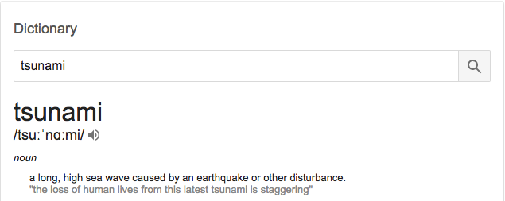

Slide 3
Tidal Wave

Slide 4
The Formation

Slide 5
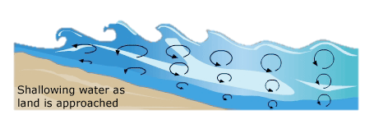
Normal Wave Due to Wind
Wind Causing the Crests and Troughs of the waves

Slide 6
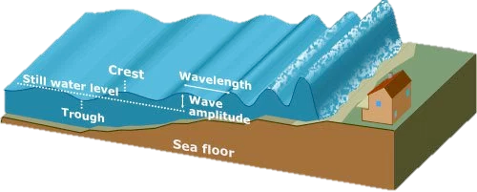
Wave Shoaling
High speed, low amplitude
Low speed, high amplitude

Slide 7
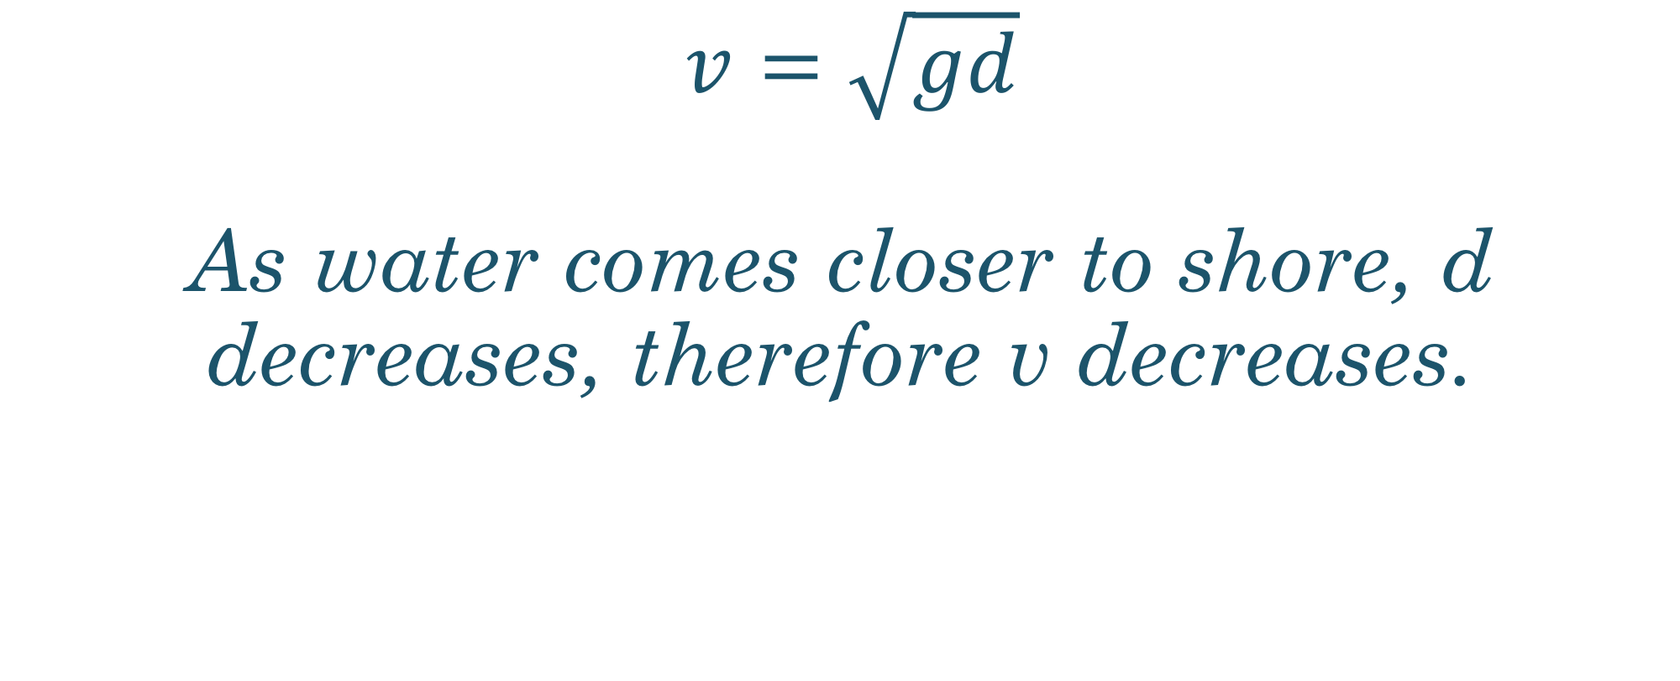
$v=\sqrt{gd}$ As water comes closer to shore, d decreases, therefore v decreases.

Slide 8
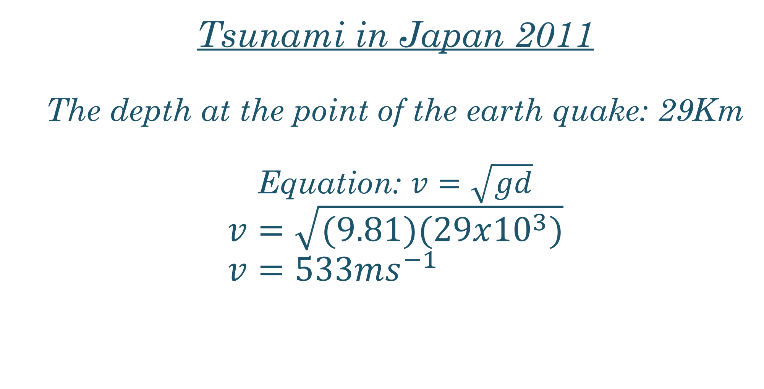
Tsunami in Japan 2011 The depth at the point of the earth quake: 29Km Equation: $v=\sqrt{gd}$ $$v=\sqrt{(9.81)(29x{10}^{3})} \\ v=533ms^{−1}$$

Slide 9
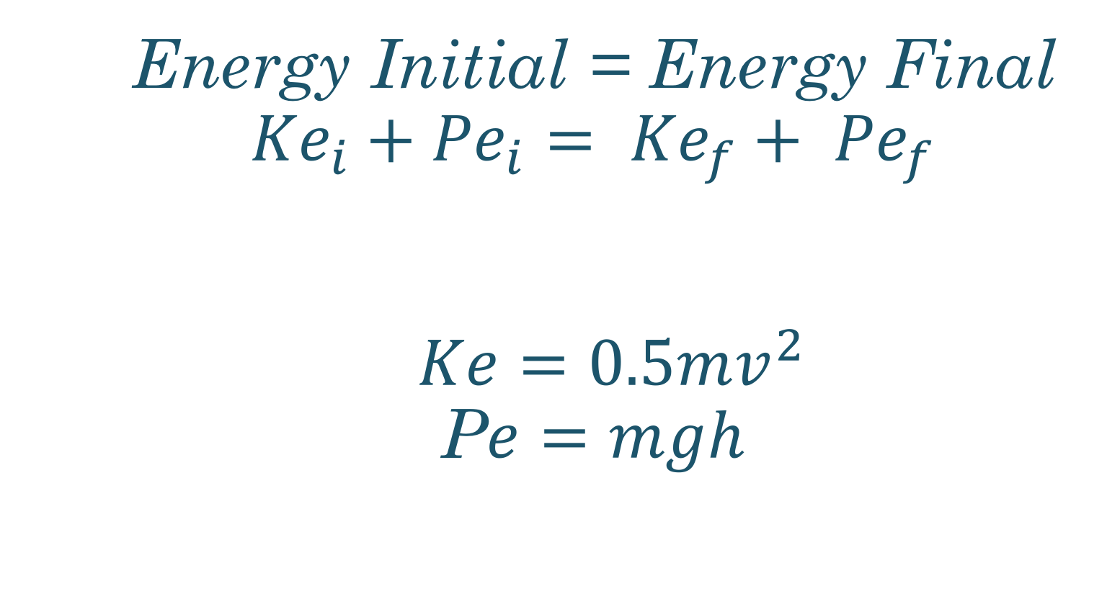
Energy Initial = Energy Final $${Ke}_{i}+{Pe}_{i}= {Ke}_{f}+ {Pe}_{f}$$ $Ke=0.5mv^{2}$ P$e=mgh$

Slide 10
Refraction
Often as a tsunami approaches at an angle, the crest that is closest will often slow down, due to shallower water. Then the rest of the wave can catch up and end up being parallel to the shoreline.

Slide 11
Boxing Day Tsunami

Slide 12
= 4.2e8 Gigajoules
x25,000

